Slide 1


#XamarinDevDays

Slide 2
Interfaces nativas Cross-Platform con Xamarin.Forms
Nombre
Twitter
Título

Slide 3
Conoce Xamarin.Forms
Crear UIs nativas para iOS, Android, y Windows
Desde un mismo archivo común, compartido C#.

Slide 4
Xamarin + Xamarin.Forms
iOS C# UI
Android C# UI
Windows C# UI
Shared UI Code
Shared C# Backend
Shared C# Backend
Enfoque tradicional de Xamarin
Con Xamarin.Forms: Más código compartido, todo nativo

Slide 5
¿Qué se incluye?
✓ 40+ páginas, layouts, y controles
(code behind o XAML)
✓ Two-way data binding
✓ Mavegación
✓ API de animaciones
✓ Dependency Service
✓ Messaging Center
Shared UI Code
Shared C# Backend

Slide 6

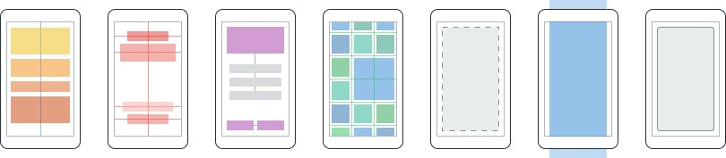
Layouts
Páginas
Content
MasterDetail
Navigation
Tabbed
Carousel
Stack
Absolute
Relative
Grid
ContentView
ScrollView
Frame
Notes:
Inside of a page are layouts
A lot of options from something simple like a stack panel to complex and powerful grids

Slide 7
Controles
ActivityIndicator
BoxView
Button
DatePicker
Editor
Entry
Image
Label
ListView
Map
OpenGLView
Picker
ProgressBar
SearchBar
Slider
Stepper
TableView
TimePicker
WebView
EntryCell
ImageCell
SwitchCell
TextCell
ViewCell
Notes:
You have more than 40 controls, layouts, and pages to mix and match from.
These are all of the controls you have out of the box, you can of course create your own.
What is unique is you get the native control and have access to it.
Consider an Entry Field
On iOS it is mapped to UITextField
Android it is EditText
Windows Phoen it is a TextBox

Slide 8


El ecosistema Xamarin.Forms

Slide 9
Comparativa de controles
Windows | Xamarin.Forms
StackPanel | StackLayout
TextBox | Entry
ListBox | ListView
CheckBox | Switch
ProgressBar | ActivityIndicator
Grid | Grid
Label | Label
Button | Button
Image | Image
Date/TimePicker | Date/TimePicker

Slide 10
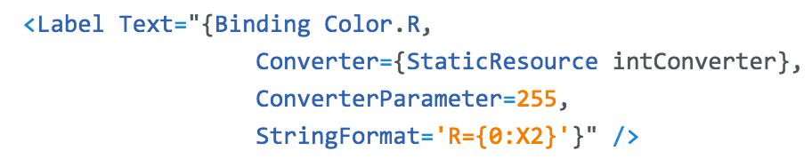
Windows | Xamarin.Forms
DataContext | BindingContext
{Binding Property} | {Binding Property}
ItemsSource | ItemsSource
ItemTemplate | ItemTemplate
DataTemplate | DataTemplate
Comparativa de enlace a datos

Slide 11
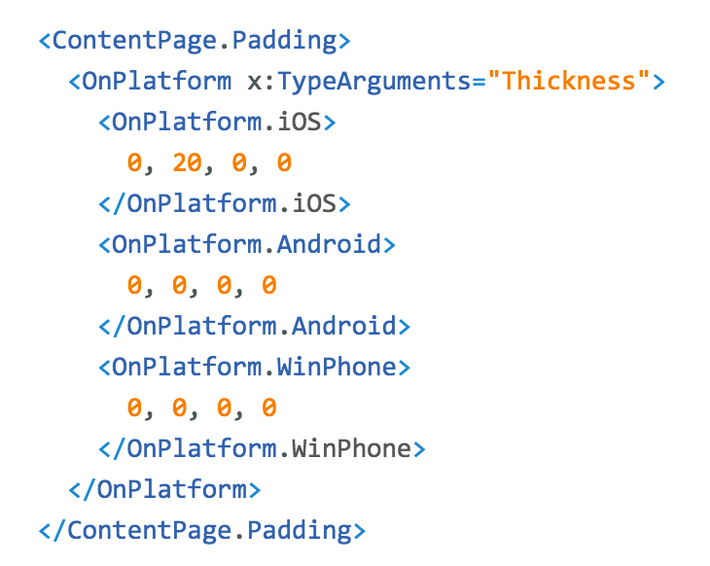
Personalización de la plataforma

Slide 12
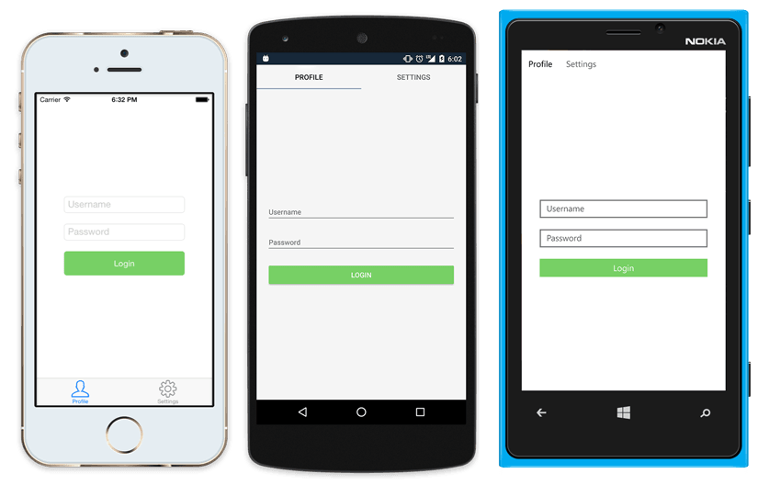
UI Nativa desde código compartido
<?xml version="1.0" encoding="UTF-8"?>
<TabbedPage xmlns="http://xamarin.com/schemas/2014/forms"
xmlns:x="http://schemas.microsoft.com/winfx/2009/xaml"
x:Class="MyApp.MainPage">
<TabbedPage.Children>
<ContentPage Title="Profile" Icon="Profile.png">
<StackLayout Spacing="20" Padding="20"
VerticalOptions="Center">
<Entry Placeholder="Username"
Text="{Binding Username}"/>
<Entry Placeholder="Password"
Text="{Binding Password}"
IsPassword="true"/>
<Button Text="Login" TextColor="White"
BackgroundColor="#77D065"
Command="{Binding LoginCommand}"/>
</StackLayout>
</ContentPage>
<ContentPage Title="Settings" Icon="Settings.png">
<!-- Settings -->
</ContentPage>
</TabbedPage.Children>
</TabbedPage>

Slide 13
Xamarin.Forms Demo

Slide 14
¿Qué hay nuevo? Xamarin.Forms 2.0!

Slide 15
Xamarin.Forms es Open Source!
open.xamarin.com
Notes:
Apple has a developer preview where Xamarin has alphas ready. Google does not offer this.
Android versions are usually 4 to 8 weeks out for a stable release, but alphas and betas are usually earlier.
Xamarin realizes how important having iOS ready because within 24 hours a large portion of iOS users upgrade
Android on the other hand is much different. After 4 months on the market Android 4.4 only had 1% adoption

Slide 16
Rendimiento Rendimiento Rendimiento

Slide 17
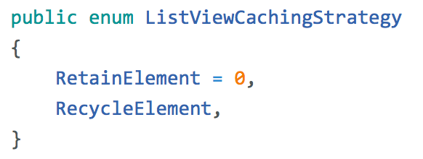
ListView CachingStrategy
✓ Mejora el rendimiendo haciendo scroll
✓ El comportamiento antiguo es el usado por defecto

Slide 18
Compilación XAML
XAML
XAMLC
Compile-time
Parsed & turned into IL
Runtime
Parsed and inflated

Slide 19
Beneficios
✓ Carga más rapida
✓ Tamaño de la App menor
✓ Ver errores XAML en tiempo de compilación

Slide 20
Diseño & Controles

Slide 21
Data Templates

Slide 22
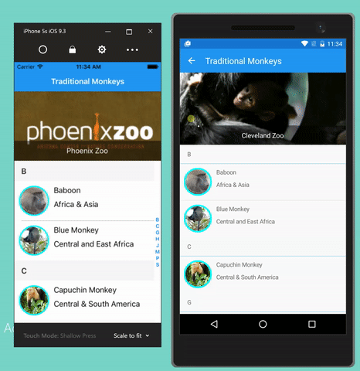
CarouselView
Carousel
ItemTemplate & DataTemplates
Altamente personalizable & Virtualizado

Slide 23
Efectos I
✓ Custom renderer “lite”
✓ Cambia propiedades en el control nativo
✓ Opcional
✓ “stringly-typed”
X No métodos o eventos
X No reemplaza el control
Notes:
A unique aspect of Xamarin.Forms is an abstraction over the user interface, but what about the platform specific functionality that makes these devices so special?
That is where plugins for Xamarin come in.

Slide 24
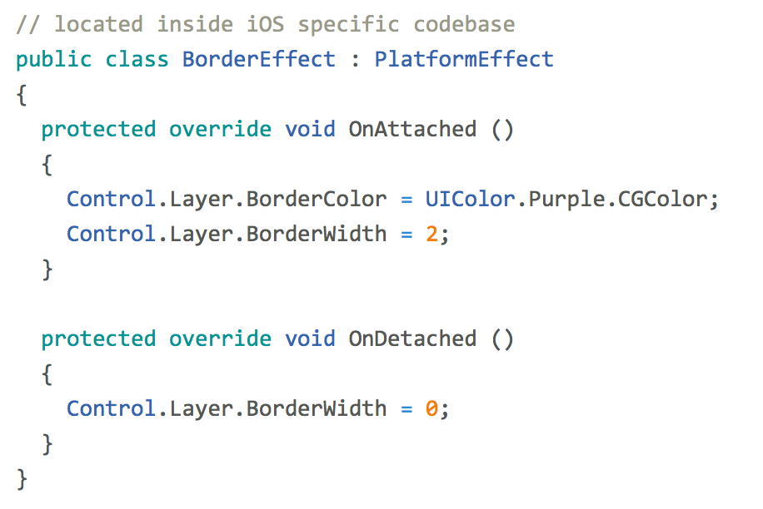
Efectos II
entry.Effects.Add (Effect.Resolve("Xamarin.BorderEffect"));
Notes:
A unique aspect of Xamarin.Forms is an abstraction over the user interface, but what about the platform specific functionality that makes these devices so special?
That is where plugins for Xamarin come in.

Slide 25
Y mucho más!

Slide 26
XAML Previewer

Slide 27
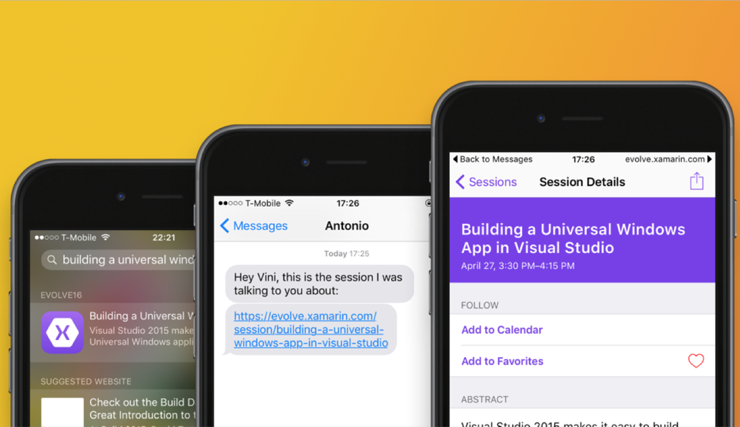
Navegación por URL
Notes:
Connect Web to Mobile
Simple cross platform API over:
CoreSpotlight
NSUserActivity
Google App Indexing

Slide 28
DataPages
https://developer.xamarin.com/guides/xamarin-forms/datapages/

Slide 29
Themes
https://developer.xamarin.com/guides/xamarin-forms/themes/

Slide 30
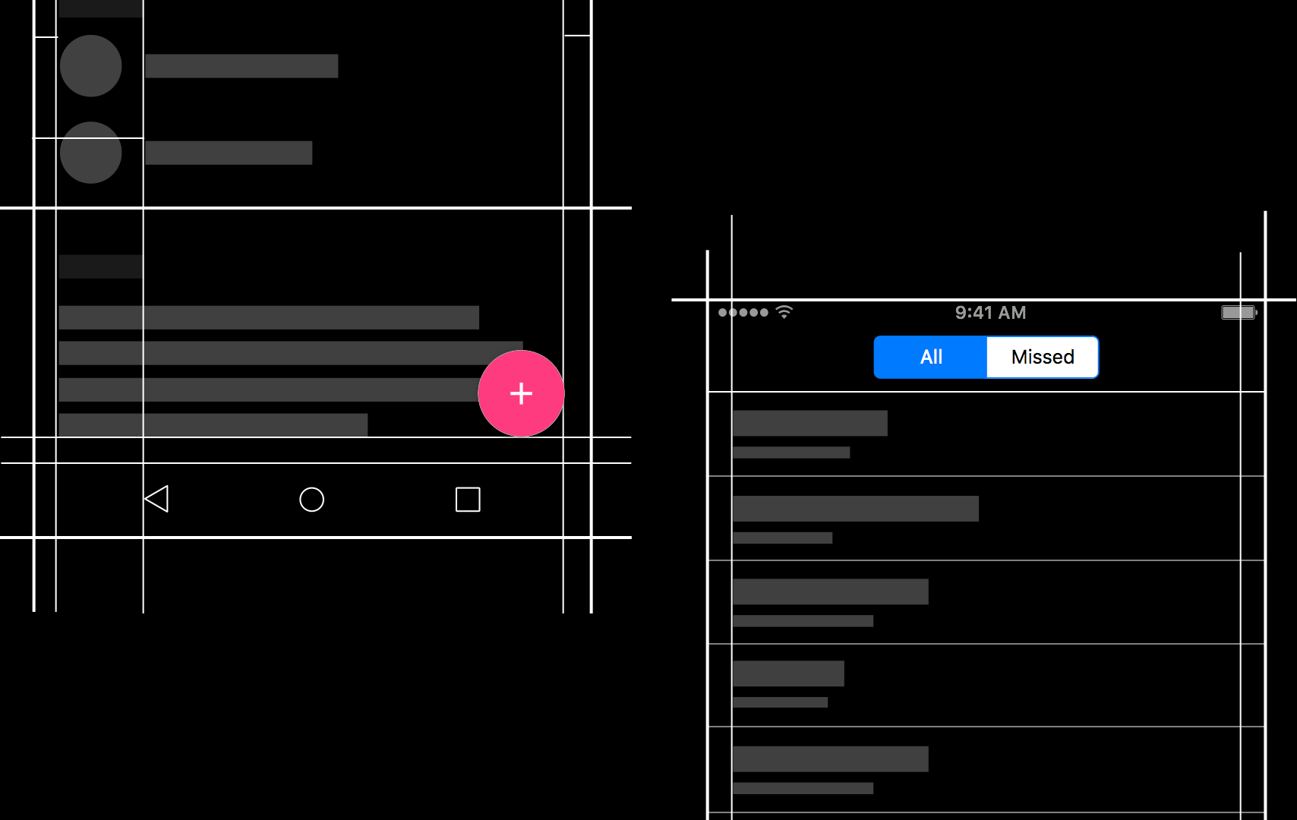
Native Embedding
Notes:
Easily embed any native control into a Xamarin.Forms layout.

Slide 31
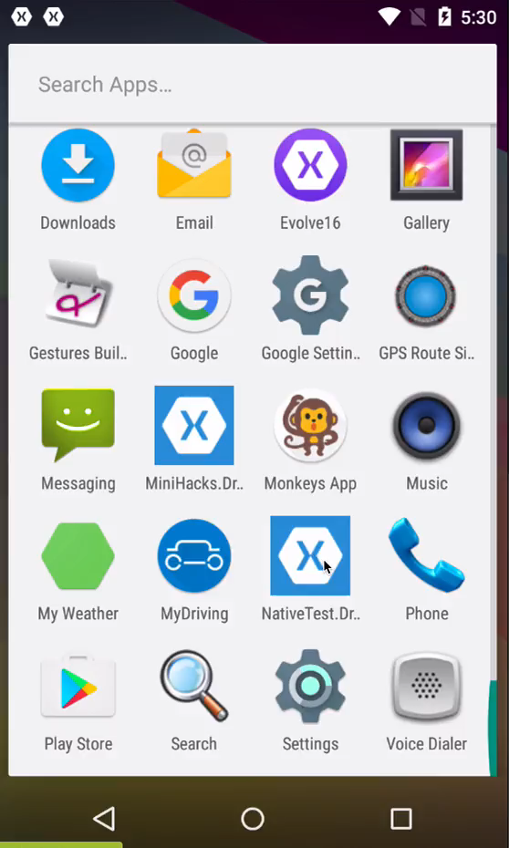
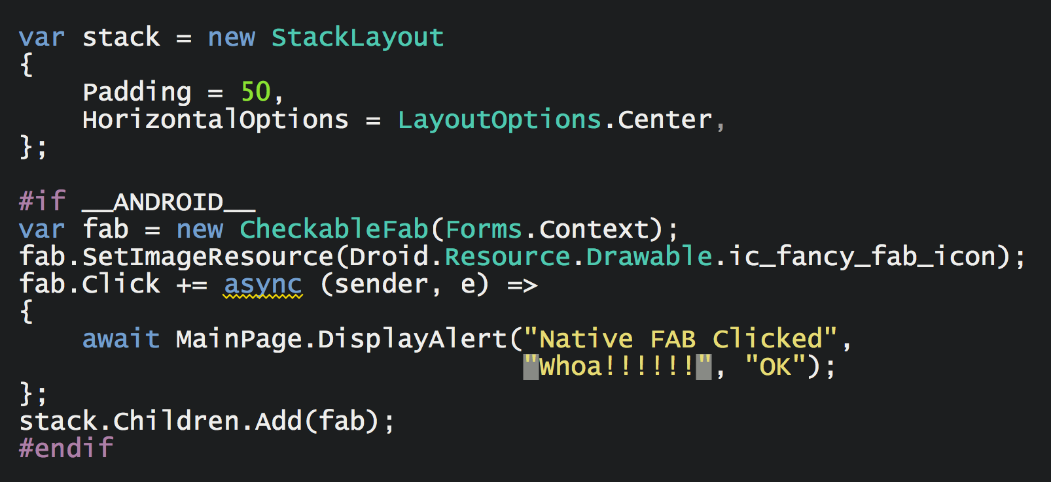
Native Embedding
Notes:
Just add it as child to a layout.
Exposed as an Extension Method.

Slide 32
20 Minutos de descanso
Nombre
Apellidos
Título
e-mail
blogs
Twitter

